Slide 1
NUTRITION OUTCOMES, SERVICES AND BEHAVIORS
UPDATED WITH PRELIMINARY RESULTS OF THE CDHS 2010

Slide 2
OUTCOMES
SECTION I

Slide 3
NOTES
All anthropometric indicators presented use the 2006 WHO growth standards
Growth standards were revised based on an internationally representative sample of healthy, breastfed children. Previous standards were based on a sub-sample of American children.
CDHS 2000 and 2005 was re-analyzed to provide estimates with the new WHO growth standards
CMDG targets have been recalculated for WHO growth standards in the 2009 CMDG gap analysis
Maternal night blindness not reported

Slide 4
Notes:
The CMDG target for iron deficiency anemia for women 15-49 is 19% with a 2010 target of 32%. Over the last 5 years there is little change in anemia status and it remains a severe public health problem, although it is encouraging that severe and moderate see steady progress, implying a general shift towards less anemia. Further progress can be reached with nationwide implementation of weekly iron folate for at-risk women. Secondary analysis is need to determine who is at risk.

Slide 5
Notes:
With improved birth spacing, we would expect improvement. Need to look at equity angle and causes. CMDG target 5.7 2010 12% 2015 8% for BMI.

Slide 6
Notes:
Looks like steady improvement--- question is does it make sense in relation to increased coverage in IFA. CMDG target 5.6 2010 target 39% and 2015 target 33%

Slide 7
Notes:
Difficult to interpret trends because indicator mixes qualitative and quantitative sources… known to underestimate---revised estimate puts 2005 level at 15%

Slide 8
Notes:
CMDG target is 19.2% for revised WHO growth standards, with a 2010 target of 24.6. Indicator is based on standard deviations, which means that a healthy population should have 2.5% underweight; at 28.3 Cambodia is more than 11x the rate of a healthy population. Underweight is the most reliable anthropometric indicator for trend analysis because it is the easiest to measure. Underweight is a composite indicator that includes both short and skinny children. It indicates acute and chronic malnutrition. With CDHS 2010 there are now three household surveys that show stagnation in improvement after the 2008 food price crisis. In 2010 food prices remain high and prices are predicted to rise further

Slide 9
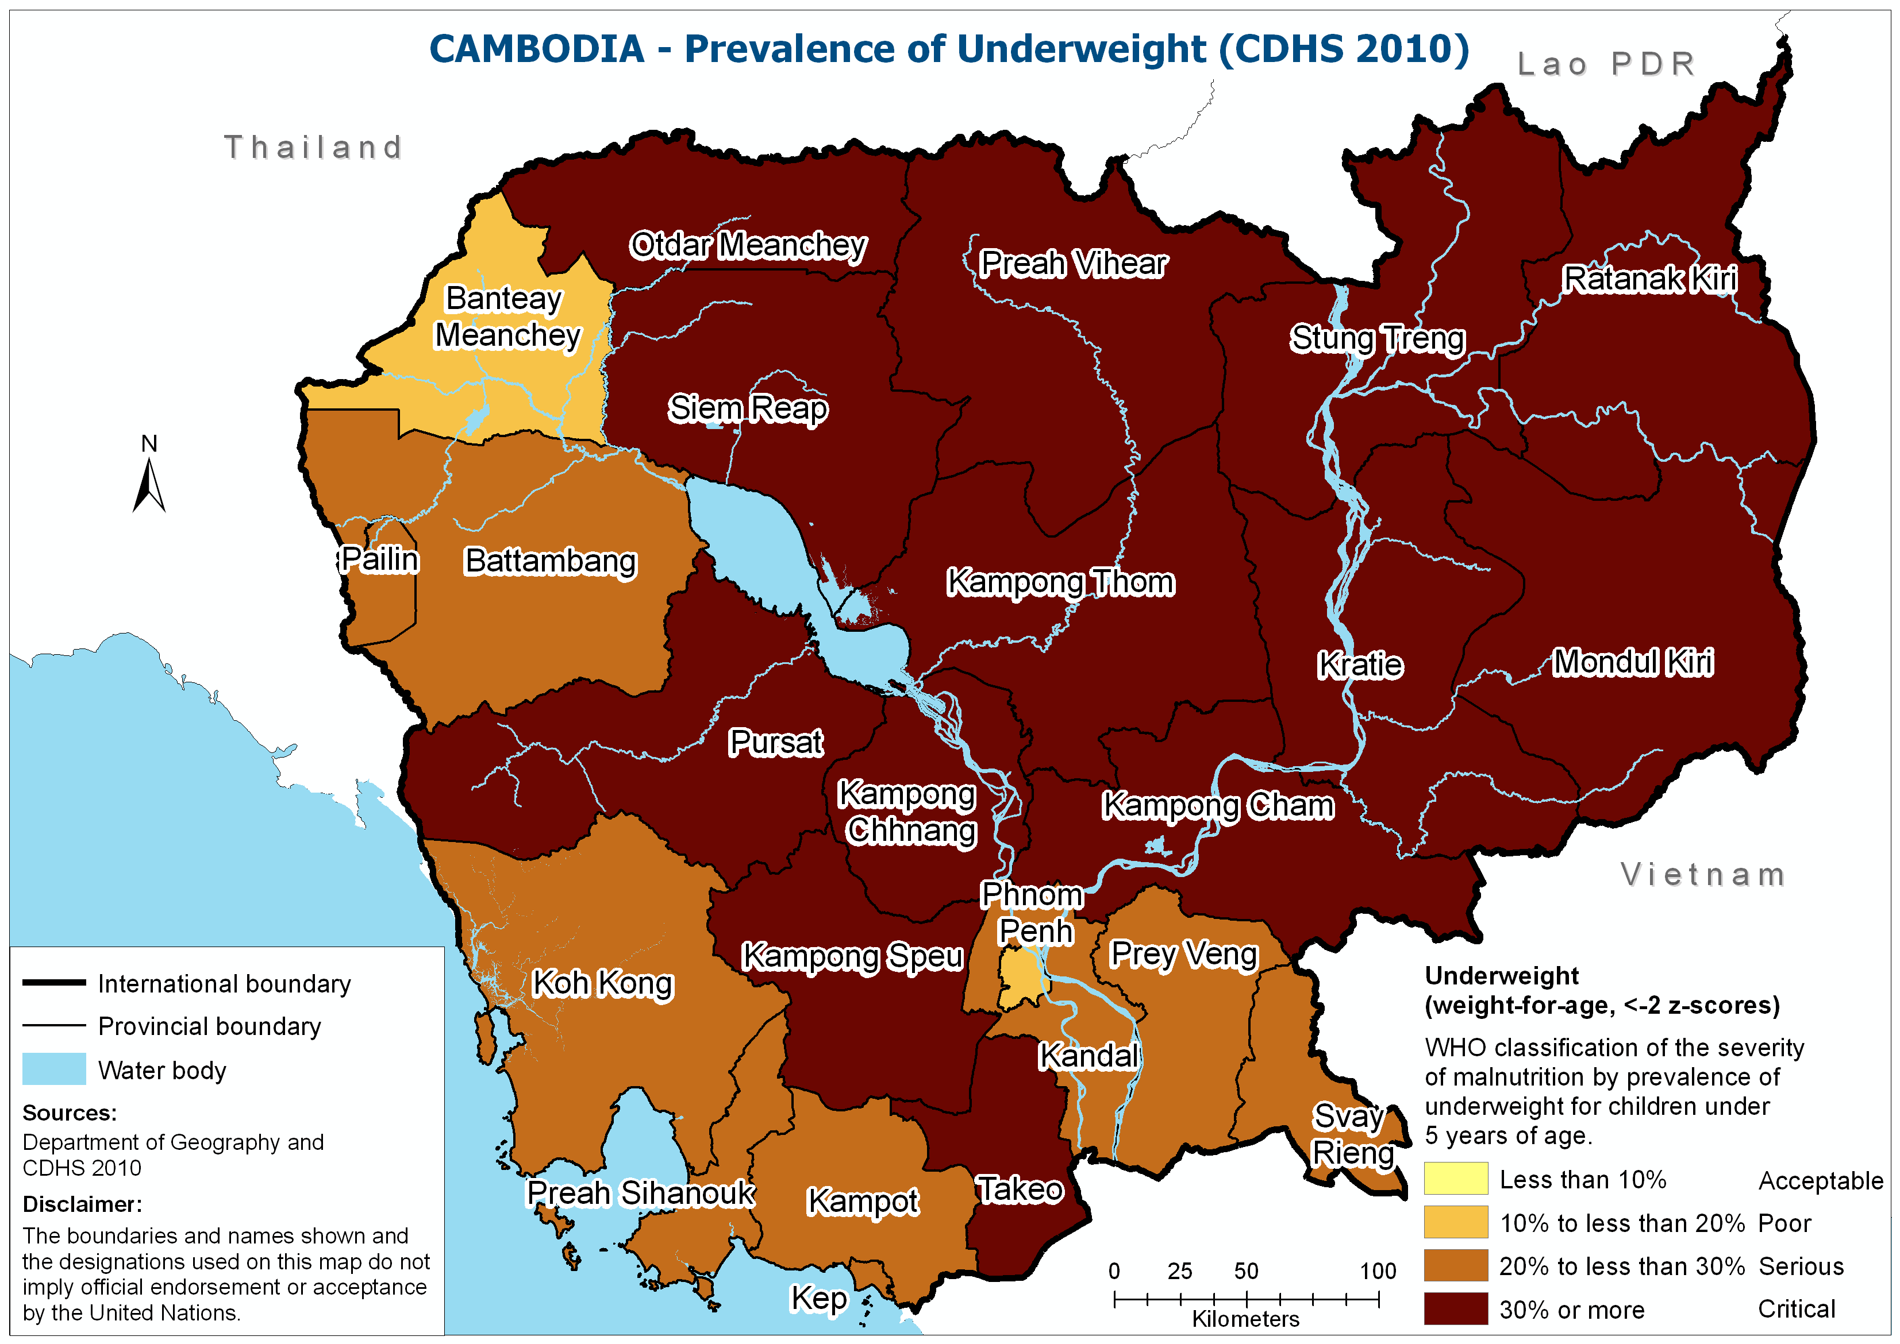

Slide 10
Notes:
CMDG target is 10.1 for revised WHO growth standards, with a 2010 target of 11.2. In 2005 Cambodia achieved the CMDG target for wasting; this progress appears to have eroded. The current rate is 4.4 times higher than a healthy population. Wasting represents skinny children and is an acute indicator; it is the most responsive indicator to short term change. Wasting is difficult to measure because it includes height; it should be interpreted with caution. However, in the context of high food prices and increasing inequity the upward trend is likely meaningful. The trend needs to be tested for statistical significance.

Slide 11
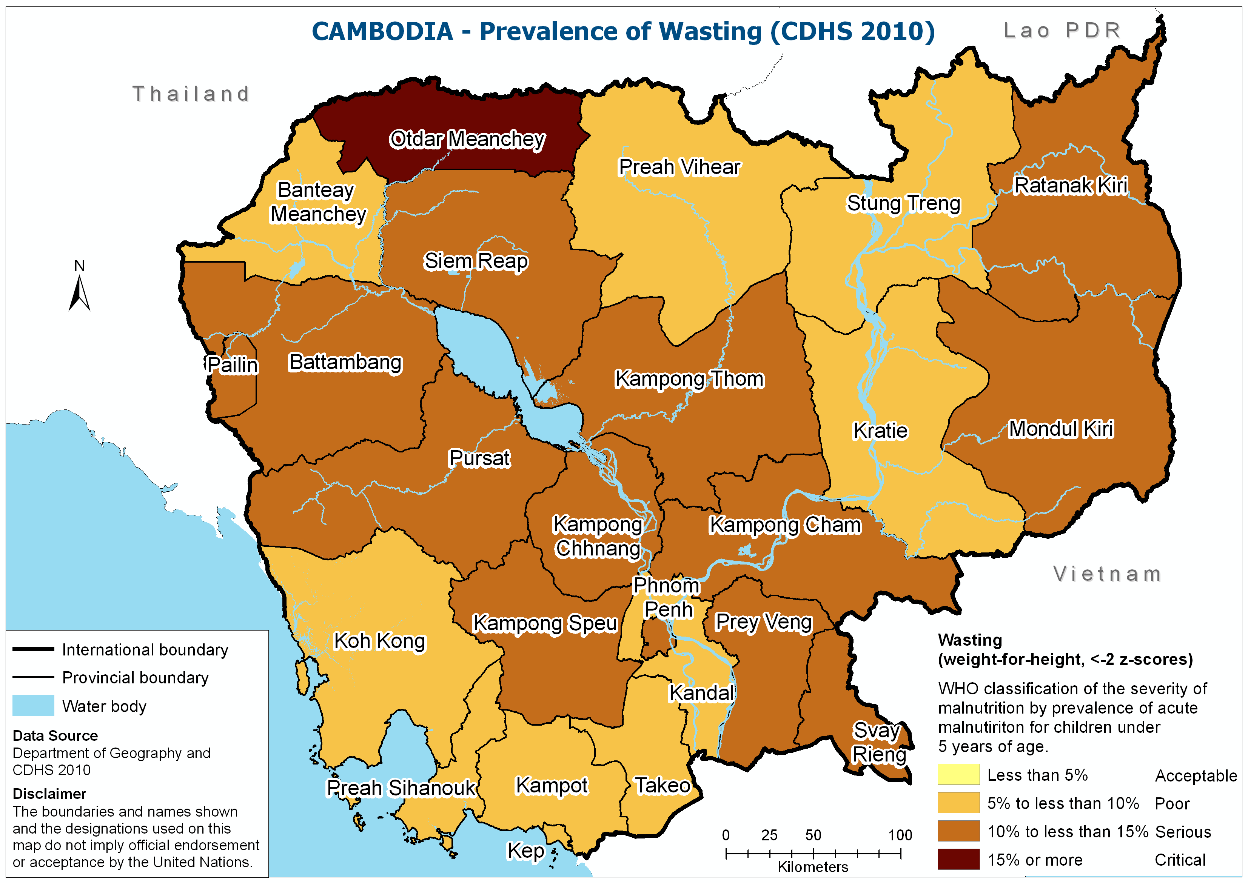

Slide 12
Notes:
Severe wasting shows a similar trend as wasting; this implies a general shift towards poorer nutrition status. Severe wasting has a high risk of mortality and requires therapeutic treatment, which can be provided outpatient from the health center or in the hospital. Based on 2008 census there are 1 373 057 children under 5; a 2.5% rate estimates 68,653 cases of severe acute malnutrition per year (incidence multiplying factor of 2). Current monitoring data suggests that only 2% of these cases are receiving treatment. This is because HC OPD treatment is not yet implemented at scale.

Slide 13
Notes:
CAS 2008 showed increasing rates of acute malnutrition among urban poor. CDHS 2010 shows increasing rates in urban areas. This is expected in the context of high food prices as net food buyers are more affected. If the entire urban population shows an increase, there is likely an alarming increase among urban poor.

Slide 14
Notes:
The CMDG target for stunting is 24.5 with new WHO growth standards, with a 2010 target of 31.2; the current rate is 16 times higher than a healthy population. Stunting represents short children and is largely irreversible after the 1st few years of life; stunting suggests a general impairment of growth, including brain development. CDHS 2010 results suggest that sustained high food prices have caused a stagnation in stunting improvement; this was not evident in 2010 b/c stunting does not respond to short term change.

Slide 15
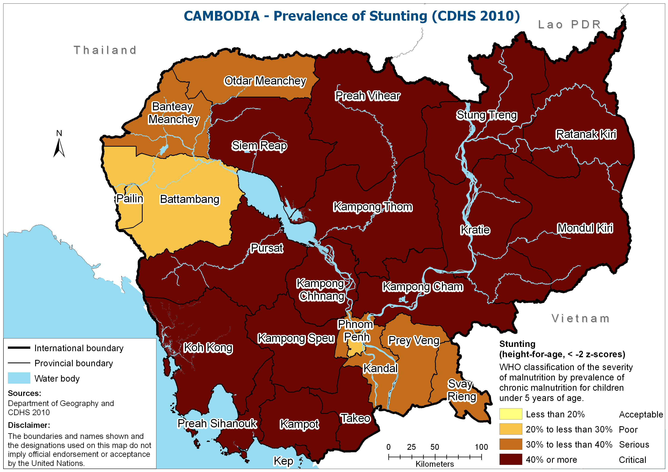

Slide 16
Notes:
There is no CMDG target for child anaemia. The National Nutrition Strategy target is 52% for 2010 and 42% for 2015. Targets are modest because of the high rate of thallasemia/hemoglobinopathy in the country. There does appear to be progress on child anemia, but it remains a severe public health problem. Further analysis is needed to determine where improvement is largest and to clarify why Pursat has a 45%pt drop and a lower rate than PP. Further gains can be expected if multiple micronutrient in home fortification is implemented at scale (Cambodia estimate is that 1/3 anemia is caused by iron deficiency); it is important to remember that even mild anemia has serious negative consequences for ability to learn and productivity. High dose preventive iron supplementation cannot be adopted because of concerns over an interaction with infectious disease leading to higher mortality.

Slide 17
SERVICES
SECTION II

Slide 18
Notes
There is no data on treatment of acute malnutrition because there is not yet a definitive plan to implement at scale. However, in April 2011 IMCI may be revised to include HC OPD treatment.
Non-Health sector services related to nutrition that are missing include homestead food production and iron fortification of fish sauce/soy sauce. These are not yet implemented at scale.
Although not yet implemented nationwide questions on weekly iron folate supplementation for women and multiple micronutrient in home fortification for children were included in CDHS 2010. Results are not yet analyzed.
New question on nutrition counseling during ANC not yet analyzed. Can add indicator on weight monitored during ANC as well.

Slide 19
Notes:
Received 90+ = no information on compliance. Is it possible to use a proxy for compliance, like education?

Slide 20
Notes:
Postpartum vitamin a is no longer recommended. Ifa drop related to decreased distribution during outreach, but we need to show this

Slide 21
Notes:
CMDG target for VAS is 90%, with a 2010 target of 85%. For child VAS CDHS 2005 and CSES 2009 have major issues with ~1/3 “don’t know” responses that are categorized as not receiving VA. This was not the case in CDHS 2000 because only one question was used (question on exact timing not used); it was not the case in 2008 because enumerators were made aware of the issue, and it is not the case in CDHS 2010 because the questionnaire has reverted back to the CDHS 2000 question. Child deworming and VAS should be exactly the same as it is distributed at the same time; not clear if this is a recall issue or a true discrepancy in service delivery.

Slide 22
Notes:
CMDG target is 90% for 2010 and 2015. 90% may be too high for coarse salt. Current coverage should be considered a success.

Slide 23
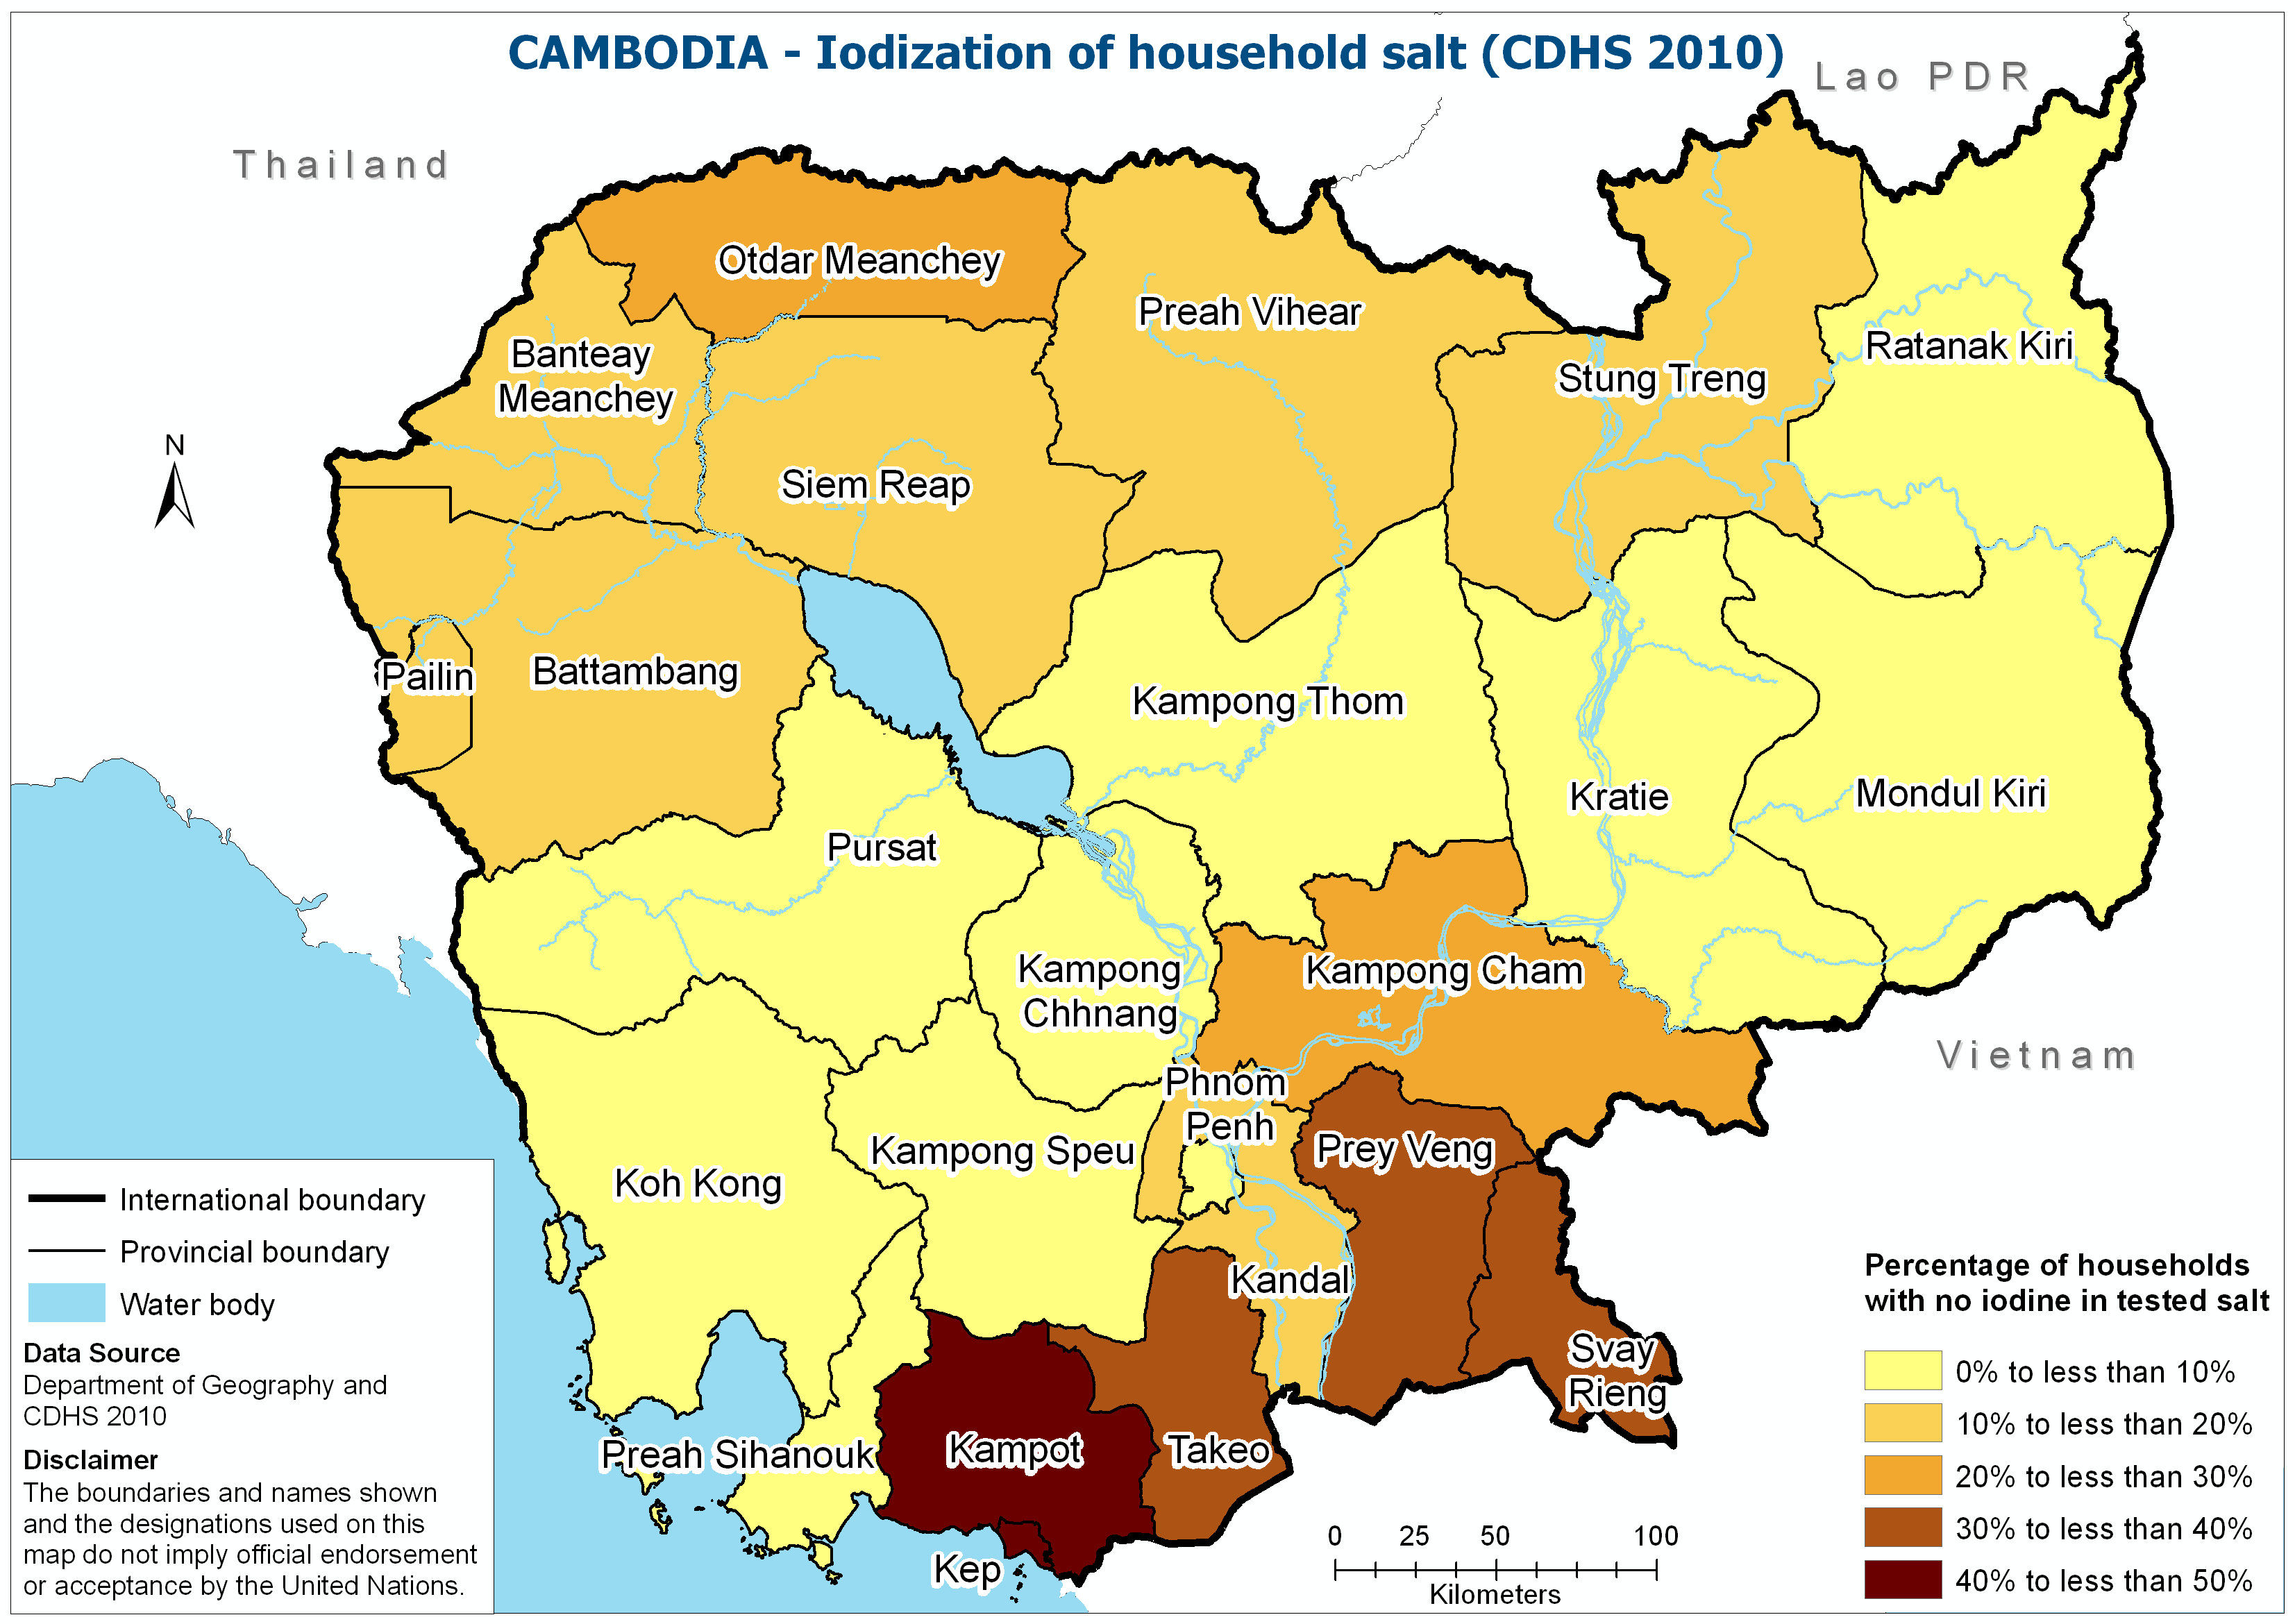
Notes:
Production leakage and importation from Vietnam still an issue

Slide 24
BEHAVIORS
SECTION III

Slide 25
Notes:
CMDG target for 1 hour is 62%, with 2010 target of 45%. Very large increase in breastfeeding within one hour. This may be related to increase in facility deliveries, but then we should have seen an increase in 2009 as well. As the skip pattern changed in the CDHS 2010 we need to make sure this has not had an impact on the indicator.

Slide 26
Notes:
NNS 2015 target is 35, with 2010 target of 45. Again, incredible change that needs to be verified by looking at the raw data to make sure skip pattern not the cause; the question is the same.

Slide 27
Notes:
Breastfeeding remains very high. Secondary analysis required to determine if formula use is starting to change this in urban areas.

Slide 28
Notes:
CMDG target is 49%, with 2010 target of 45. Incredible progress over the last 10 years is a major cause of the drop in infant mortality. 2000 level is an underestimate because a different question was used starting in 2005. Revised estimate for 2000 is 47%.

Slide 29
Notes:
Less mothers giving water is the main reason for improved EB rate.

Slide 30
Notes:
While EB rate is 3 out of 4 children, it is important to keep in mind that this is not the probability of child reaching six months of age with exclusive breastfeeding. 40% of mothers are not EB at 4-5 months.

Slide 31
Notes:
EB seems to be keeping bottle use low among the youngest children, but there is a large increase after 6 months. Secondary analysis needed to calculate 2000 levels, to see if more common in urban areas and to determine impact on nutrition outcomes.

Slide 32
Notes:
There is slow progress on the timely introduction of complementary food, but 1 out of 10 children 6 to 9 months is not receiving food other than liquid based, including breastmilk. At 6 months of age breastmilk can no longer satisfy the nutritional requirements of a child and solid food should be introduced.

Slide 33
Notes:
~4% of children 12-23 months are not living with their mother and are not included in this indicator. There seems to be a slow decrease in continued breastfeeding. Secondary analysis needed to determine if this is related to more mothers working.

